Slide 1
Electric Power Outage Analysis

Slide 2
Objective
Electric outages are a growing concern with significant energy demand and climate disasters.
Data: Event level power outage data from 2002 Severe issues with data quality and integrity
The goal is to consolidate and clean up the raw data, and create a dashboard/report to help us understand patterns and trends around outages, quantify their impact on our communities, and identify possible weak points in the grid.

Slide 3
Data Consolidation
Python and Excel used for cleaning and consolidating the data.
All the years had different columns and hence I created same columns by some transformations
2002 to 2010 : Removed the month rows , splitted restoration date and time into two columns to match the other datasets. Also formatted the datatype of time and date.
2011 to 2014: Removed the month rows.
2015 to 2022: Removed the month column.
2023: Removed the month and year column.
Combined all the sheets to create one final dataset.

Slide 4
Data Cleaning
Number of customers affected column cleaning: 1 PG&E as 1 1.5 million as 1500000 Blanks as Unknown Approx 70000 as 70000 94,366 at peak, total 225,353 as 225353 8,000 -10,000 as midpoint/average 9000
Time column: Midnight as 12:00 am Evening as 6:00 pm
NERC region: PR if area affected is Puerto Rico, HI if Hawaii
Manual date entry mistakes were rectified while calculating difference of days between event date and restoration date
Missing date of restoration values filled with date of event values as the median value of date difference was 0.

Slide 5
Insights
Built various dashboards for my analysis
Some of the insights from my analysis are:
As the demand loss increased, the number of customers affected also increased.
Average number of customers affected is higher in the state Nevada followed by Florida.
If the outage event is restored on the same day, the number of customers affected is less and vice-versa
Vandalism is the top most event type which was restored on the same day.
Severe weather is the top most event type which was not restored on the same day.
Outages were maximum in August month.

Slide 6
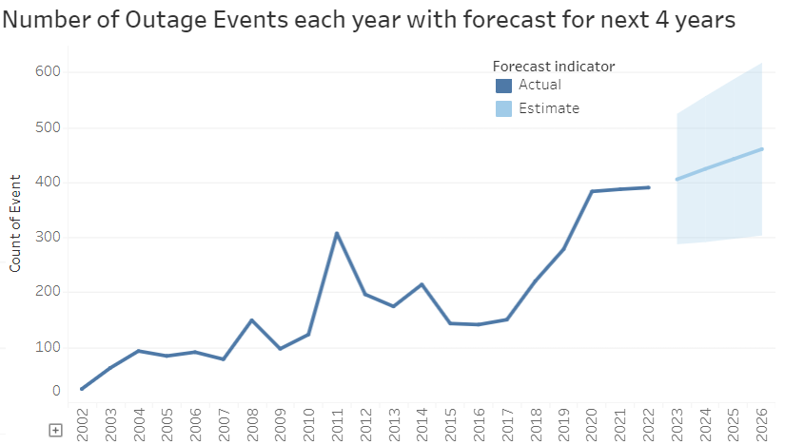
Forecast of Outages
Below image shows the forecast with an increasing trend

Slide 7
Summary:
Environmental factors are one of the main causes for the outages which cannot be controlled or stopped, but definitely precautionary measures would not harm.
The forecast is an evidence indicating the increase in the number of outage events in the coming years.
Even though most of the outages caused by vandalism are restored on the same day , it is also one of the major causes which indicates negligence and security issues.
Loss of electric service to more than 50000 customers for 1 hour or more is the top alert criteria, which can be useful to take precautionary measures before the outage occurs.

Slide 8
Recommendations
Invest in eco-friendly infrastructure and renewable energy sources to mitigate environmental impacts.
Develop adaptive strategies based on the forecasted increase in outage events, allocating resources efficiently.
Enhance security measures, deter vandalism, and implement rapid response protocols for immediate restoration.
Conduct public awareness campaigns to educate and foster responsibility in reporting suspicious activities.
Leverage predictive analytics and advanced technologies for early detection and preventive actions.
Invest in redundant systems and backup power solutions to minimize the impact of extended outages.
Establish a robust investigation process to continually improve security measures, preventive strategies, and response mechanisms.

